Slide 1
Introduction to Public Health
Module # 5
Re-emerging infectious diseases, HIV/AIDS, TB.
DR. SHAIKH ABDUS SALAM
Dept. of Public Health
North South University
Dr.Shaikh Abdus Salam

Slide 2
OBJECTIVES OF THE LECTURE
By the end of this lecture you will be able to:
Conceptualize
  HIV/AIDS, risky groups for getting HIV/AIDS
  Mode of transmission & prevention
  Current situation of HIV/AIDS in Bangladesh
Understand the use of Anti-retroviral therapy in treating AIDS cases in Bangladesh.
Dr. Shaikh Abdus Salam
1

Slide 3
HIV
HIV: Human Immunodeficiency Virus
  Spread through contact with the blood, semen, pre-seminal fluid, rectal fluids, vaginal fluids, or breast milk of a person infected with HIV
Symptoms
  Flu-like symptoms, such as fever, headache, or rash
  Symptoms may come and go for a month or two after infection
  Severe symptoms: chronic diarrhea, rapid weight loss, and signs of opportunistic infections (infections and infection-related cancers that occur more frequently or are more severe in people with weakened immune systems)
HIV transmission is possible at any stage of HIV infection—even if an HIV-infected person has no symptoms of HIV

Slide 4
AIDS
  AIDS: Acquired Immunodeficiency Syndrome
  Most advanced stage of HIV infection
  Time varies, may take 10 years or more
How AIDS diagnosed:
  CD4 count (white blood cell) < 200 cells/mm3
  Normal CD4 count ranges 500- 1,600 cells/mm3.
  AND/OR
  The person has one or more opportunistic infections (occur more frequently and are more severe in individuals with weakened immune systems)

Slide 5
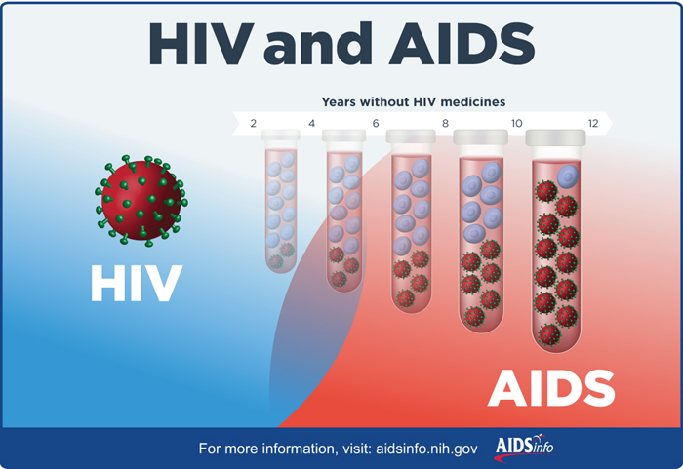
HIV & AIDS

Slide 6
Some important terminologies
PrEP: Pre-Exposure Prophylaxis is an HIV prevention option for people who don’t have HIV but who are at high risk of becoming infected with HIV. PrEP involves taking a specific HIV medicine every day. PrEP should always be combined with other prevention options, such as condoms.
PEP: Post-exposure prophylaxis involves taking antiretroviral (ARV) medicines very soon (within 3 days) after a possible exposure to HIV to prevent becoming infected with HIV.
ART: antiretroviral therapy is the use of HIV medicines to treat HIV infection. ART involves taking a combination of HIV medicines every day. ART can’t cure HIV infection, but it can help people infected with HIV live longer, healthier lives. HIV medicines can also reduce the risk of transmission of HIV.

Slide 7
Prevention of HIV
Getting tested and know your partner’s HIV status
Having less risky sex
Using condoms
Limiting number of sexual partners
Getting tested and treated for STDs
Talking to health care provider about pre-exposure prophylaxis (PrEP)
Not injecting drugs

Slide 8
HIV/AIDS in Bangladesh
1st case was detected in 1989
Overall prevalence is less than 1%
BUT high level among injecting drug users- 7% in one part of Dhaka city
Limited access to voluntary counseling and testing services
Extremely vulnerable on HIV epidemic due to:
  Poverty
  Over population
  Gender inequality
  Transactional sex

Slide 9
Risk factors
  Injecting drug users
  20,000-40,000 injects drugs
  57% borrow needles
  74% female injecting drug users
  57% injecting drug users are married
  With an average of 2 partners
  Sex workers
  Unprotected sex with wives and sex workers
  Low condom use
  Risky behavior
  Lack of understanding about HIV is not limited to clients of sex workers

Slide 10
Risk factors (contd.)
MSM
  Largely hidden
  Powerful stigma
  Discrimination
  Rarely use condoms
Migrant workers
  250000 people leave each year
  47 out of 259 were infected migrants (icddr,b)
  57 out of 102 new cases were migrant (2004)

Slide 11
HIV and AIDS estimates in Bangladesh
Number of people living with HIV 9600 [8400 - 11 000]
Adults aged 15 to 49 prevalence rate <0.1% [<0.1% - <0.1%]
Adults aged 15 and over living with HIV 9300 [8100 - 11 000]
Women aged 15 and over living with HIV 3200 [2800 - 3600]
Children aged 0 to 14 living with HIV <500 [<500 - <500]
Deaths due to AIDS <1000 [<1000 - <1000]
Orphans due to AIDS aged 0 to 17 5100 [4100 - 6200]
Notes:
UNAIDS 2014

Slide 12
Tuberculosis (TB)
Caused by bacteria
Usually attack the lungs
Can also attack any part of the body- kidney, spine, and brain
Transmission
  Through the air from one person to another
  Coughs, sneezes, speaks, or sings
  Nearby people may breathe in these bacteria and become infected

Slide 13
Latent TB infection
  People who are infected, but not sick
  Do not feel sick, do not have any symptoms, and cannot spread TB to others
  Some people with latent TB infection go on to get TB disease
TB disease
  Immune system can’t stop TB bacteria from growing
  The bacteria begin to multiply in the body and cause TB disease
  The bacteria attack the body and destroy tissue . If this occurs in the lungs, the bacteria can actually create a hole in the lung

Slide 14
Symptoms:
  A bad cough that lasts 3 weeks or longer
  Pain in the chest
  Coughing up blood or sputum
Other symptoms
  Weakness or fatigue
  Weight loss
  No appetite
  Fever
  Sweating at night

Slide 15
DOTS
Directly Observed Treatment Short course (DOTS)
  Meet with a health care worker every day or several times a week
  Meet at a place you both agree on: TB clinic, your home or work, or any other convenient location
  Take your medicines at this place while the health care worker watches
  May need to take medicines only 2 or 3 times each week instead of every day

Slide 16
Importance of continuing medicine
Treatment requires a multidrug regimen (a course of treatment) for at least 6 months to kill all the TB bacteria
TB bacteria die very slowly
Must continue to take medicines until all the TB bacteria are dead
If don’t continue taking medicines or not taking all medicines regularly, the TB bacteria will grow and will remain sick for a longer time
The bacteria may also become resistant to the medicines (MDR)
May need new, different medicines to kill the TB bacteria if the old medicines no longer work. These new medicines must be taken for a longer time and usually have more serious side effects

Slide 17
TB situation in Bangladesh
Both a high TB and a high MDR-TB burden country in the South East Asian
Epidemic of TB in Bangladesh estimated at 402 per 100,000 population
190,000 cases notified each year
1.4% of all new TB cases and 29% among retreatment cases are estimated to be drug resistant
Each year around 70,000 people die of TB

Slide 18
Challenges in TB treatment in LMIC
Role of the Private Sector
  NTP does not always acknowledge the role of private sector
Issues of Access and Community-Based Care
Health Care Worker Shortage
A Dangerous Duo: Poverty and Stigma

Slide 19
Treating Tuberculosis and
HIV/AIDS Together
Generally the priority is to initiate treatment for TB
Depending on clinical indications, starting ART
  after the initial phase of TB treatment is completed OR
  after the entire course of TB treatment is completed
If indicated, treatment for both HIV and TB can be started parallel, but careful management is needed
When a patient with HIV-associated TB who has been started on ART and TB treatment simultaneously experiences a paradoxical worsening with exacerbation of symptoms, signs
Paradoxical reaction occurs from
  a reconstitution of the immune system and
  may be accompanied by a high fever, expanding central nervous system lesions, and worsening of chest x-ray findings

Slide 20
THANK YOU
Dr.Shaikh Abdus Salam

